Slide 1
Nepal travel: Discover Hidden Natural Retreats
Group:5
Presenters
Aashish karki (24080262)
Kismat giri (24080282)
Sugat katuwal (24080304)
Under Supervision of
Mr. Sanju Shrestha

Slide 2
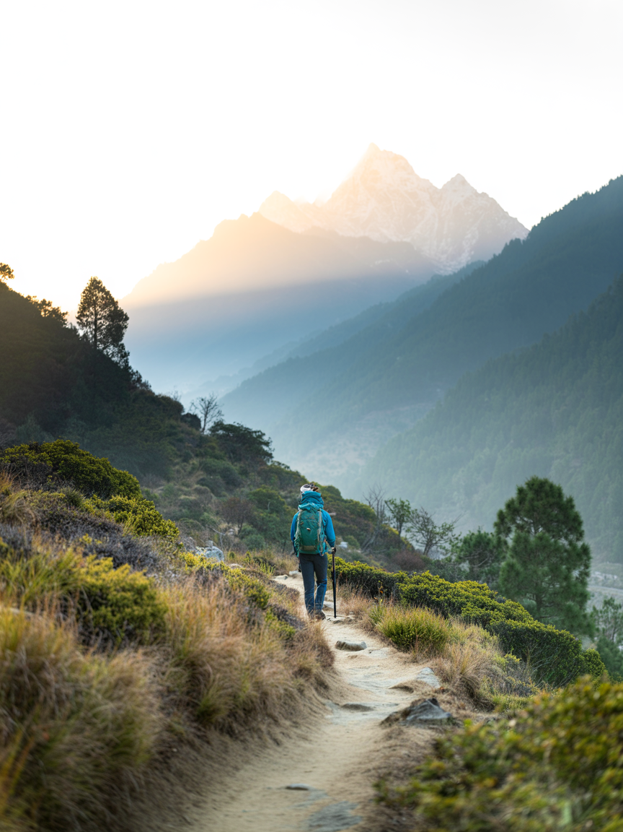
Introduction : What & Who
Nepal Travel: Discover Hidden Natural Retreats
Nepal Travel is a platform designed to help users discover hidden natural places across Nepal. It focuses on lesser-known destinations such as forests, hills, lakes, and peaceful viewpoints. The platform allows travelers and locals to explore, share, and review travel experiences.
Users can access useful information like routes, seasons, photos, and travel tips. The system aims to promote local tourism and make trip planning easier and more reliable.

Slide 3
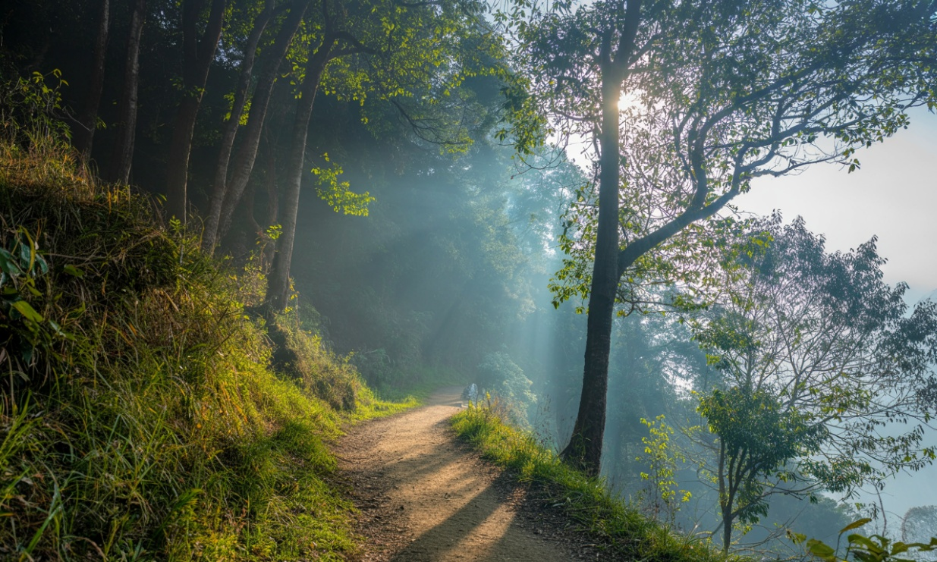
Motivation & Problems
Hidden places dispersed across social media and word-of
mouth — hard to discover.
Travel decisions are difficult without reliable, consolidated info.
Local gems lack exposure and preservation incentives.
Visitors need trustworthy, practical details (routes, seasonality,
highlights).

Slide 4




Objectives
Find hidden places
Build a growing list of nature getaways across
Nepal with useful details.
Simple search and filters
Search by activity, difficulty, season, trip length,
and region.
Community sharing
Let locals and travelers add places, reviews,
and photos.
Plan trips easily
Save places to collections, add notes, and
Organize future trips.

Slide 5
Methodology
Requirement Analysis : Identify user needs like finding hidden places, viewing details, and saving
locations.
System Design : Create UI wireframes and design the database structure.
Frontend Development : Build interface using HTML, CSS, and JavaScript.
Backend Development : Develop server-side logic using PHP.
Database Creation : Store user data and place information using MySQL.
Map Integration : Use Google Maps for location display.
Testing : Check for errors, bugs, and proper functionality.
Feedback & Improvement : Collect feedback and enhance the system.

Slide 6




Tech Stack & Comparison
Backend
PHP
Database
MySQL
Frontend
HTML/CSS/JS
XAMPP, Git Hub, VS code
How we compare
Focus on Hidden Gems Unlike mainstream travel platforms, we prioritize lesser-known natural spots instead of overcrowded tourist destinations.
Community-Driven Content Users can share real experiences, photos, and tips—making the platform more authentic and constantly updated.
Local-Level Details Provides practical info like routes, transportation options, entry fees, best time to visit, and safety tips specific to Nepal.
Personalized Collections Users can save and organize places into custom lists (e.g., “Weekend Chill Spots”, “Solo Trips”, “Near Kathmandu”)

Slide 7
Project progress
Completed tasks
Frontend Development
Homepage with destination listing and spotlight picks
Login and registration page with clean UI
Destination detail page (name, description, trip info, budget, facilities)
Add destination form with multi-step structure (Basics, Story, Media, Route, Cost, Stay)
Admin dashboard
Search and filter interface
Database & Backend
All core database tables created (Users, Places, Reviews, Collections, Saved Places, Photos, Routes, Categories)
Foreign key relationships defined between tables
User registration and login (Traveler / Admin)
Admin activities ( verify, manage places)
Google map api integration
OTP verification while signing up
User authentication

Slide 8
Feedbacks and improvements
Google Maps Integration
The map feature on the destination detail page was not working properly and was advised to make it smooth.
Review System
The reviews from the users were hard to locate. One of our friend advised us to make visible clearly and was fixed.
Save/Bookmark Feature Users weren't sure if their "save" action had actually worked since there was no confirmation. A small visual cue (icon change/toast message) was added to confirm when a place is saved.
Search & Filter Functionality Users found it difficult to filter destinations by category (mountains, lakes, waterfalls, etc.) as the filter options were not clearly labeled. This was fixed by adding clearer category tags and a more intuitive filter bar.

Slide 9
Future recommendations
Complete Backend & Communication Features Enhance the remaining backend modules with advanced user notifications, messaging, and communication features
to provide a smoother experience for travelers and administrators.
Develop Mobile Applications Create dedicated Android and iOS applications so users can easily explore destinations, plan trips, and access travel information directly from their mobile devices.
Offline Access & Real-Time Weather Allow users to save destination information for offline use, especially useful in remote trekking areas, and integrate real-time weather updates to help users plan their trips safely.
Analytics & Tourism Partnerships Add advanced analytics for administrators to track popular destinations, user engagement, and platform growth, while collaborating with tourism boards, trekking agencies, and local communities to expand and verify destination information.

Slide 10
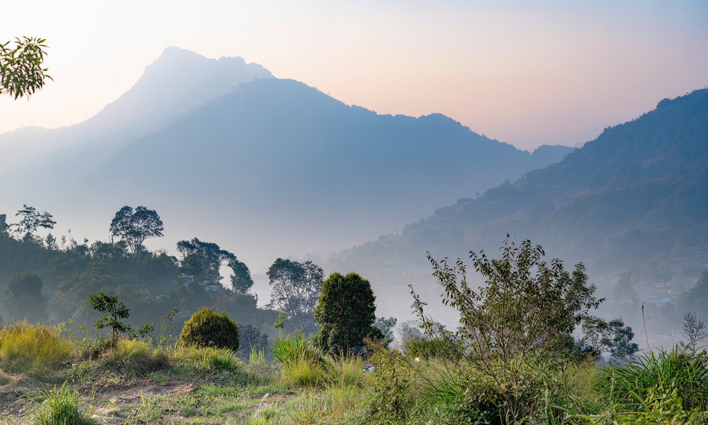
Conclusion
Nepal Travel is more than a trip-planning platform — it is a way to discover hidden gems, share trusted local knowledge, and make every journey more meaningful.
Helps travelers uncover authentic places beyond the usual tourist paths
Empowers local communities by giving them visibility and a stronger voice
Makes trip planning easier with trusted details, routes, and seasonal tips
With Nepal Travel, exploration becomes more connected, more personal, and more impactful.

Slide 11
Thank you…

